Slide 1
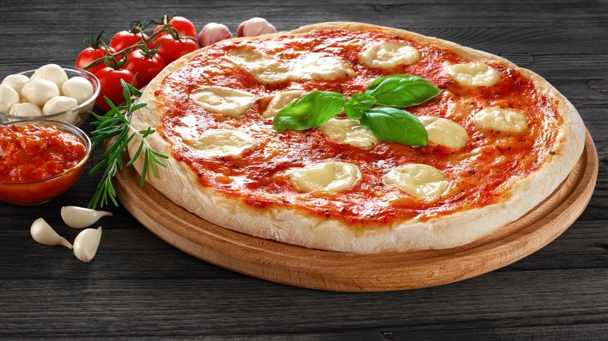
Where to Open your Pizza Place - With the Power of Clustering
Applied Data Science Capstone - Final Project - Saumya Gupta
This Photo by Unknown Author is licensed under CC BY-SA-NC

Slide 2
Locations can make or break your business.
Stockholm said to be the capital of Scandinavia, is also one of the leading food-tech hubs in the world.
You could be a business trying to find locations to set up your new Pizza place or someone trying to set up their first restaurant ever in Stockholm County.
Where to set up your Pizza place poses a problem, given how crucial it is to the success of your place.
You cannot risk wasting money and want to know at least where to start looking!
If you can somehow get a bunch of districts that you can start looking at, knowing that these districts have a great potential of serving your business since they are similar to each other based on the types of venues they have. Above all, most of these districts have Pizza Place as their most commonplace, which tells you that Pizza has to connect these districts. Wouldn’t it be great?

Slide 3
The solution will be great, but what will we do to achieve that?
What do we do?
In a nutshell, we try and cluster the districts of Stockholm County based on the number of different types of venues they hold.
We do this using a very simple and easy to understand centroid based clustering algorithm - K-Means clustering.
Using the technique, we achieve various clusters. (We try and find the number of clusters we want to achieve in the process)
We examine the clusters and find that one cluster where Pizza places are the most commonplace for most districts.
How is that helpful?
That way, we know, these districts are connected primarily because of their scores for Pizza places.
Within the cluster, our client can choose the district with Pizza as their most commonplace. If that district seems flooded with those already, they can choose another district (based on other specific requirements) in the same cluster that does not have too many such joints but does have a potential for profits for a new joint if they open one!

Slide 4
Data Acquisition and Cleaning
Geo-coordinate Data
It contains the latitude and longitude information of the districts of Stockholm County.
We use a tab-delimited file for Sweden we find from http://www.geonames.org/ (Website provides postal code data for nearly 100 countries along with their geo-coordinate information).
We get the data for Stockholm County from there.
We receive postal code level information, but we eventually convert it to district level geo-coordinate information due to some inconsistencies faced at the postal-code level.
Finally, we have Neighbourhood (name), Latitude and Longitude columns (first 5 rows).

Slide 5
Data Acquisition and Cleaning
Foursquare Venue Data
We use the geo-coordinate information of each neighbourhood (or district) to find the information of the venues in the 500 meters radius of each neighbourhood.
For this, we use access to the Foursquare Explore API.
We create a developer account with Foursquare and then use the generated credentials for development work (client_id, client_secret) to call the Explore API.
For a neighbourhood, apart from the geo-coordinate data (ll) and the user credentials, we also need to mention the radius (radius) within which we want to retrieve all venues, a limit (limit) that defines the number of results the API should return and the version (v) of the API, which is a date and accesses a particular version of the API.

Slide 6
Data Acquisition and Cleaning
Foursquare Venue Data (contd.)
From the API, data is received in JSON format, converted to a tuples format list.
Finally, we have Neighbourhood (name), Venue (name), Venue Category (first 5 rows).
One neighbourhood can have multiple venues.

Slide 7
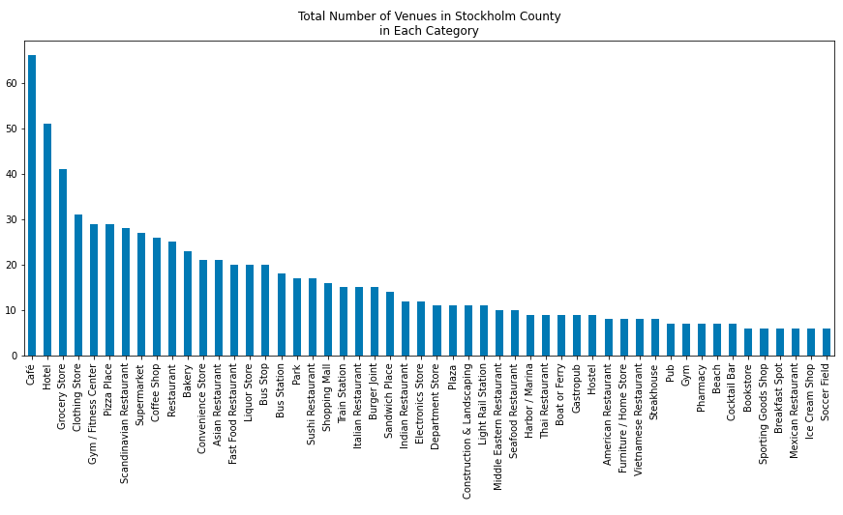
Exploratory Finding
Stockholm County has 32 Pizza places in total which are the 4th most common venues in the County.
Note: 32 sounds very small and unreal but remember that this number is based on the results from the Foursquare Explore API, and the actual number might be higher than this one.

Slide 8
K-Means Clustering Analysis
K-Means Algorithm for Clustering
K-Means is inexpensive, simple to understand and easy and fast to implement.
We use elbow plots to find out which K-value (number of clusters) to use. Five seems to be the curve elbow in both distortions and inertias curves.

Slide 9
K-Means Clustering Analysis
K-Means Algorithm Input Data
We assign each neighbourhood a score for each venue category (type of venues such as Pizza Place, Hotel, and Coffee Shop).
A high score for a venue category will represent a higher frequency within that neighbourhood.
This data serves as the input to the clustering machine and is also used while choosing K-value.

Slide 10
K-Means Clustering Analysis
Here are the before and after of clustering the neighbourhoods of Stockholm County into clusters 0, 1, 2, 3 and 4 based on the number of different venues they hold.
Note: Some of the dots missing in the right map is because of the filter that removes the less common venue categories from the input data.

Slide 11
Cluster Examination
For cluster evaluation, we find the top 10 most common venues for each neighbourhood and then merge the cluster number assigned by the K-Means function.

Slide 12
Cluster Examination
Cluster 1 has the most districts (77 districts), and clusters 0, 2, 3, 4 have 6, 5, 3 and 3 districts.
Since our client wants to open a Pizza place, we try to see if any cluster has a Pizza place as the most common venue category for most of the districts present in that cluster.
We ignore clusters 2, 3 and 4 as they do not have any neighbourhoods with Pizza places as their first most commonplace.

Slide 13
Discussion and Conclusion
For cluster 1, only two districts have Pizza place as their most common venue. Pizza places do not seem to be the driving factor for all these districts belonging to cluster 1, but Hotels seem to be. Suppose these two districts already have sufficiently many Pizza places. In that case, there is not much certainty of a beneficial outcome for the client's Pizza place in the other districts since Pizza place is not a very common venue in other districts of the cluster.
In the cluster 0, 3 districts have Pizza places as their first most common venue. Our client could choose to go for a location in any of these five districts. Suppose, for some reason (maybe, after looking at other factors such as population to Pizza place venue ratio or population affordability), the client does not want to open in these districts and decides to open in any other district in this cluster. In that case, there is much certainty of the success of the Pizza place. These districts belong to the same group because of their similar frequencies of Pizza places. So, if it works so well in A, but A has sufficient venues already, it will also work so well in B, which could use one more Pizza place.
Based on the examination of our clustering results, we recommend our prospective client / our future Pizza place owner in Stockholm County to start exploring the six districts in cluster 0. These could serve potential profits to him/her. Using this information and based on his/her other requirements and further research on demographics and relevant data, our client can move forward and make a decision.

Slide 14
Thank you

